Slide 1
Power Sub-Mesh Construction in Multiple Power Domain Design
Chien-Pang Lu, Iris Hui-Ru Jiang, Chung-Ching Peng, Mohd Razha Mohd Mawardi, Uber Akessandro
Intel Cooperation
National Taiwan University
Presenter : Min-Feng Hsieh
Advisor : Ting-Chi Wang

Slide 2
Outline
Introduction
Preliminaries
Methodology
Experimental Results

Slide 3
Outline
Introduction
Preliminaries
Methodology
Experimental Results

Slide 4
Introduction
Primary / secondary power mesh : high / low layer stripe.
Multiple power domain design is prevalent for achieving aggressive power savings
Power delivery to cross-domain cells poses a tough challenge at advanced technology nodes.
IR drop constraint
Routing source competition between the secondary power routing and regular signal routing.
Explore power sub-mesh construction to mitigate the IR drop issue for cross-domain cells and minimize its routing overhead.
the routing between the secondary power pins on cross-domain cells and power sources

Slide 5
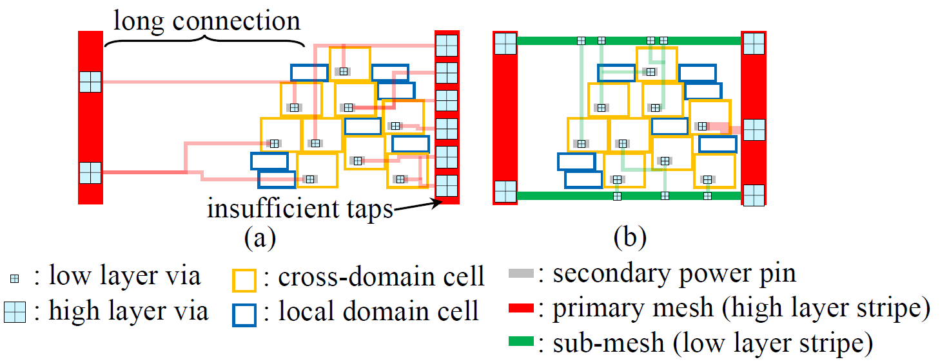
Introduction
Primary power mesh occupies high layers
High layer vias are relatively large at advanced technology nodes.
Each of its stripes can offer a limited number of tapping vias.
If a secondary power pin is not tapped to the nearest power stripe due to limited tapping vias or local congestion.
It will take a long connection to a distant stripe and in turn induce a severe IR drop due to high resistance.
Notes:
他們現在遇到的問題

Slide 6
Introduction
To resolve the issue, a local power sub-mesh can be constructed on lower layers.
Provides smaller and more tapping vias.
Avoids long connections and maintains low resistance.

Slide 7
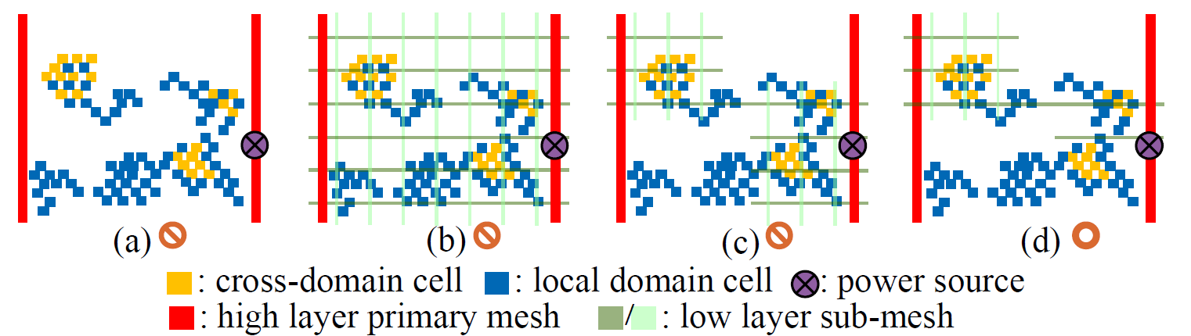
Introduction
Cross-domain cells are irregularly distributed in a layout.
Notes:
(b) sub-mesh會佔據太多routing resource，因而導致signal routing很多DRVs
(c) sub-mesh只佔據在cross-domain cell附近
(d) 減少更多不必要的sub-mesh

Slide 8
Introduction
Starts with a full sub-mesh with the best IR drop, and repeatedly removes unnecessary sub-meshes.
Until the IR drop constraint cannot be satisfied.
While the IR drop analysis in each iteration is time-consuming.
They train two models under power sub-meshes of various densities.
IR drop prediction model
Design rule violation prediction model
The trained models effectively guide sub-mesh construction for cross-domain cells to budget the routing resource usage on secondary power routing and signal routing.

Slide 9
Outline
Introduction
Preliminaries
Methodology
Experimental Results

Slide 10
Preliminaries
Power Domain
A collection of cells that use the same power supply during normal operation.
Can be switched on or off at the same time.
There are numerous multiple power domain cells (cross domain cells)
Always-on buffers/inverters, retention flip-flops, isolation cells.
They contain pins called secondary power pin.
There are 2 types of power source for a cross-domain cell
Direct supply: primary power mesh directly supplies power to the cross-domain cells.
Indirect supply: power gating cell (MTCMOS), level shifter.

Slide 11
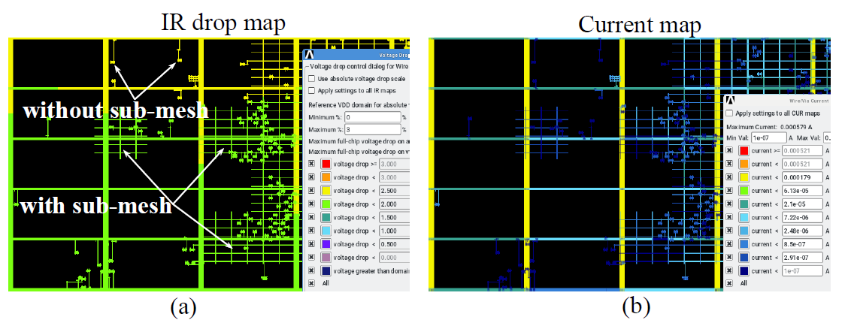
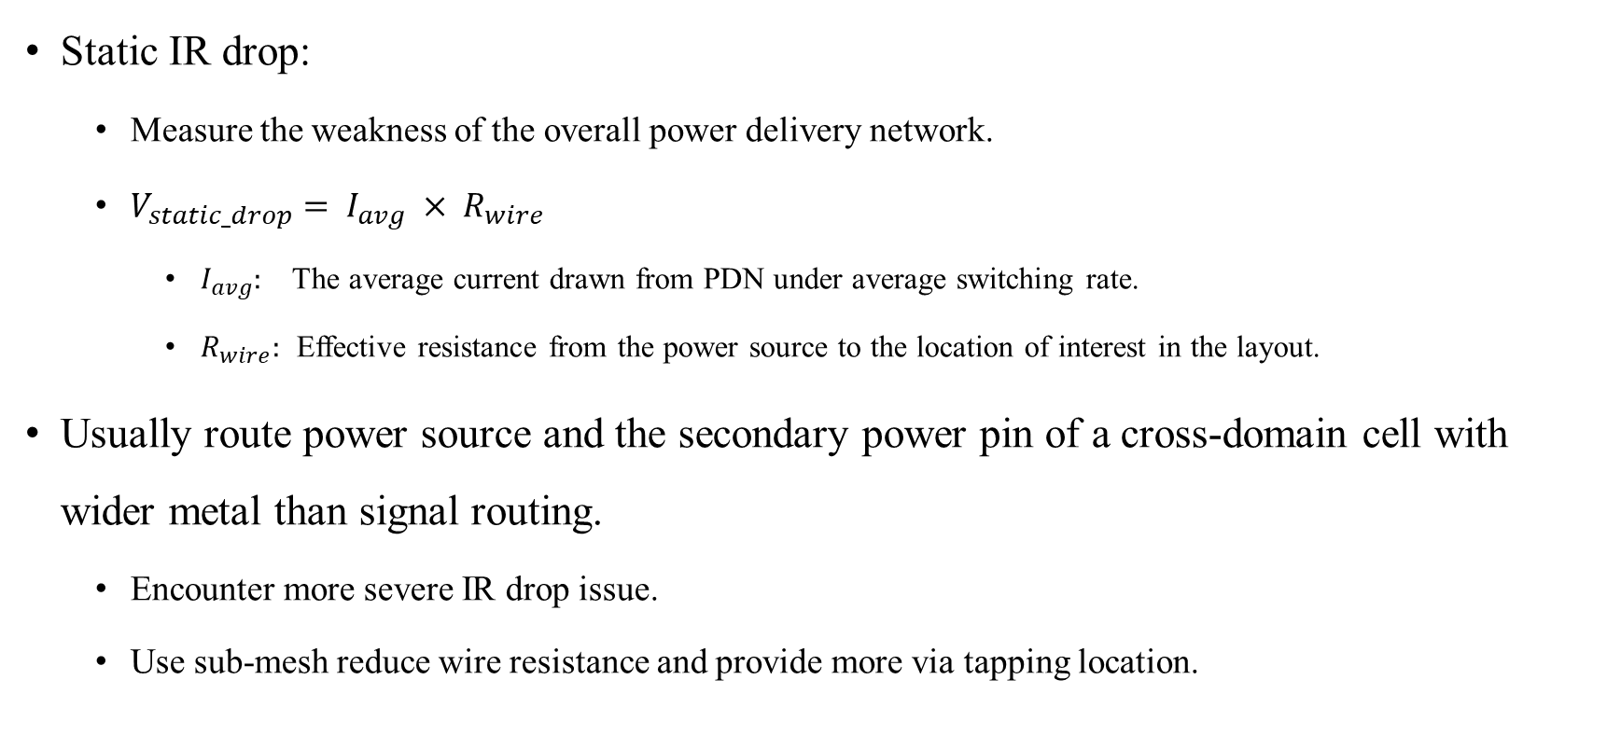
Preliminaries
Static IR drop:
Measure the weakness of the overall power delivery network.
$V_{static_drop}= I_{avg} × R_{wire}$
$I_{avg}:$ The average current drawn from PDN under average switching rate.
$R_{wire}:$ Effective resistance from the power source to the location of interest in the layout.
Usually route power source and the secondary power pin of a cross-domain cell with wider metal than signal routing.
Encounter more severe IR drop issue.
Use sub-mesh reduce wire resistance and provide more via tapping location.
Notes:
Set by non-default routing rule
線越寬，電阻越小

Slide 12
Preliminaries
Problem input
A timing-driven placed and clock-routed multiple power domain design.
A set of cross-domain cells and corresponding power sources, primary power mesh and signal routing distributions (global routing).
Goal
To construct power sub-meshes such that the IR drop constraints on cross-domain cells are satisfied.
Design rule violations on signal routing are minimized without timing degradation.

Slide 13
Outline
Introduction
Preliminaries
Methodology
Experimental Results

Slide 14
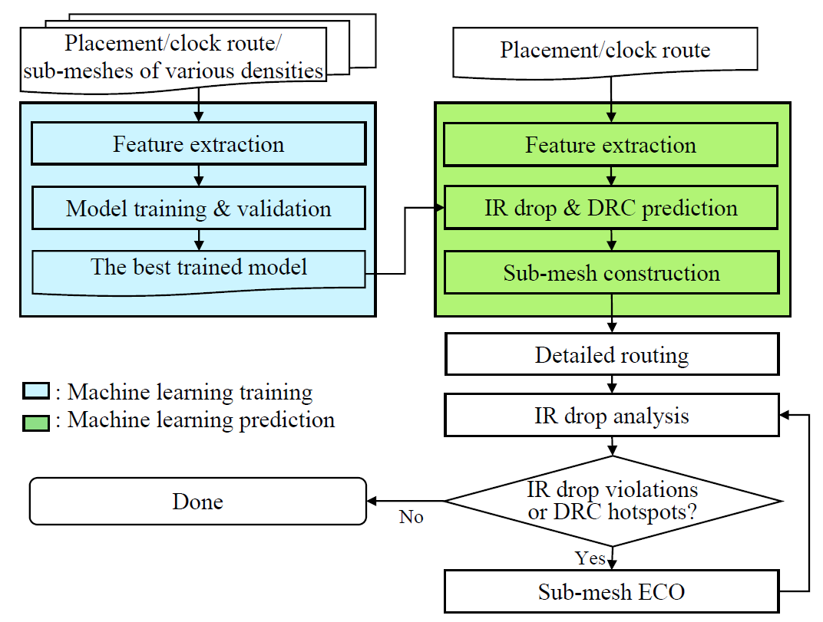
Methodology

Slide 15
Methodology – Feature Extraction
Training layouts are generated by a multiple power domain design with different densities of sub-meshes.
The training layout is partitioned into uniform grids.
The datasets contain around 20K cross-domain cell instances
Split them into training and validation sets with 80 : 20 split ratio.
Perform normalization and standardization on the data feature values before the training process

Slide 16
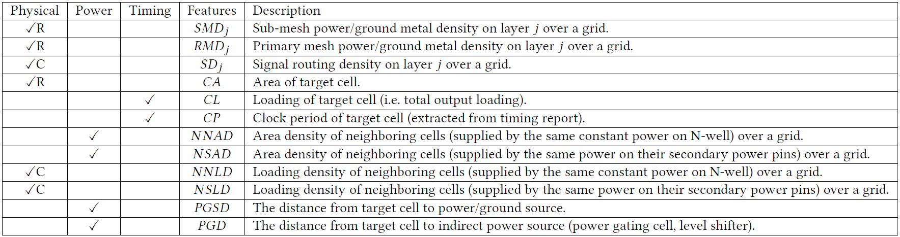
Extract 46 features for each target cell.
Target cell: cross-domain cell
Furthermore, in the training phase, they collect two target variables
The static IR drop value of each cross-domain cell (with direct or indirect supply) reported by the IR drop simulation tool
DRC hotspot grids from detailed routing
Notes:
N-well恒定电源：专门针对N-well区域的恒定电压供应，主要影响N-well内的P型MOSFET晶体管。
电源网络/电源轨：覆盖整个芯片的电力传输系统，提供不同电压轨以满足不同模块的电源需求。

Slide 17
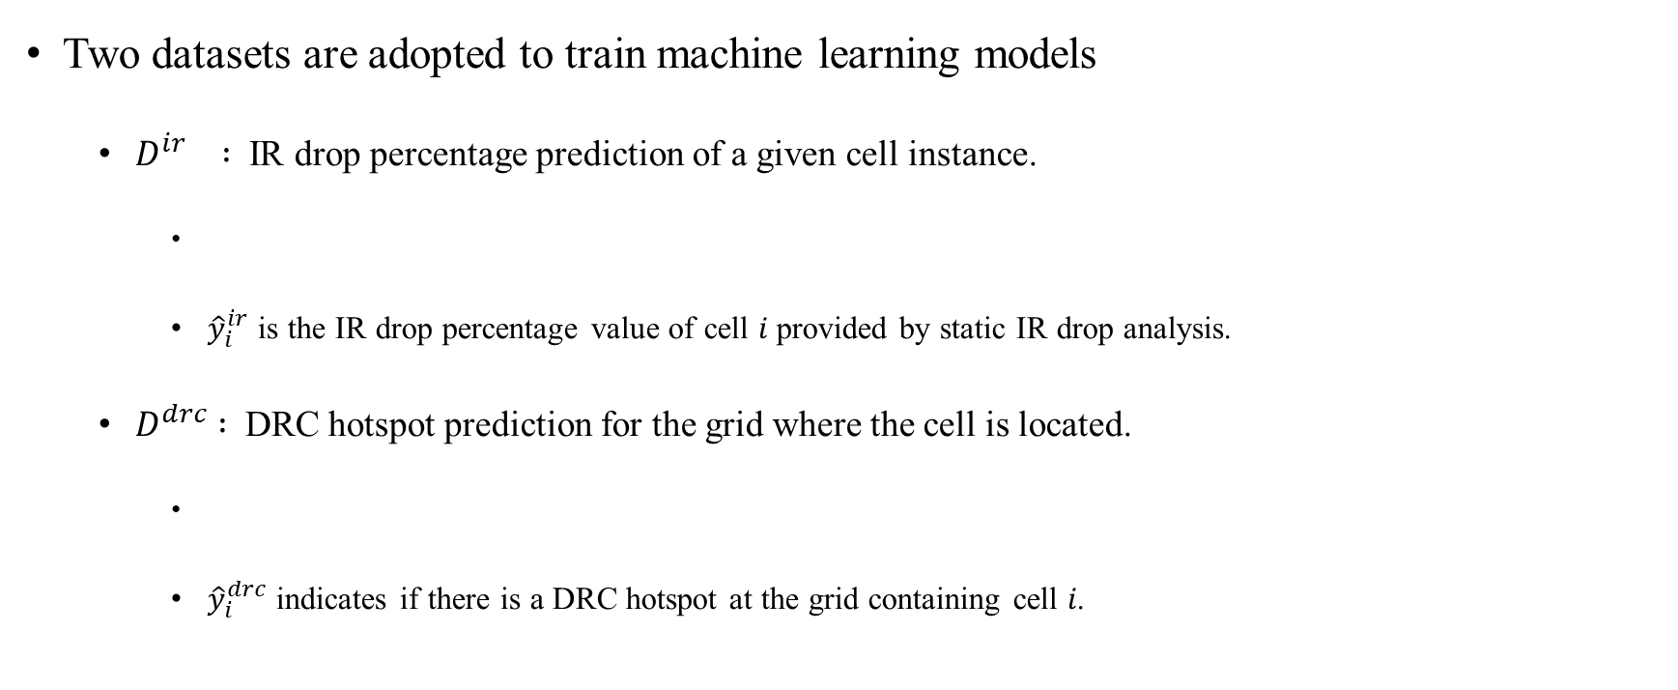
Methodology – ML Model
Two datasets are adopted to train machine learning models
$D^{ir} :$ IR drop percentage prediction of a given cell instance.
${\hat{y}}_{i}^{ir}$ is the IR drop percentage value of cell 𝑖 provided by static IR drop analysis.
$D^{drc} :$DRC hotspot prediction for the grid where the cell is located.
${\hat{y}}_{i}^{drc}$ indicates if there is a DRC hotspot at the grid containing cell 𝑖.

Slide 18
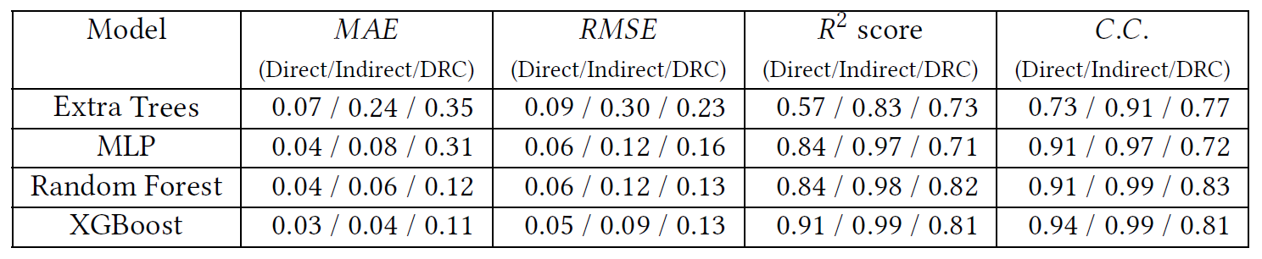
Methodology – ML Model
They trained multiple regression models and output the model with the best prediction performance on the validation set.
Extra Trees
MLP (ANN)
Random Forest (RF)
XGBoost
The best model is trained by XGBoost.
Direct: IR drop on cross-domain cell with direct supply.
Indirect: IR drop on cross-domain cell with indirect supply.
DRC: DRC hotspot in a grid.
Notes:
MAE: mean absolute error
RSME: root mean square error
C.C.: Correlation coefficient
构建树的方式
随机森林（RF）：
每次构建决策树时，随机森林从原始训练集中使用**自助采样（bootstrap sampling）**抽取样本，这意味着从数据集中有放回地抽取相同数量的样本作为一个树的训练数据。
在分裂数据点时，每个节点会从随机选定的特征子集中选取最优特征来进行分裂。
极端随机树（Extra Trees，也称为Extremely Randomized Trees）：
极端随机树在构建每棵树的时候使用整个原始数据集，不进行自助采样。
在选择分裂节点时更为极端，不仅在一部分随机选定的特征中进行选择，而且对于每个特征分裂的阈值也是随机选定的，然后选择出这些随机生成的分裂中最好的一个来分裂节点。这个过程增加了随机性，减少了模型对数据的过拟合。

Slide 19
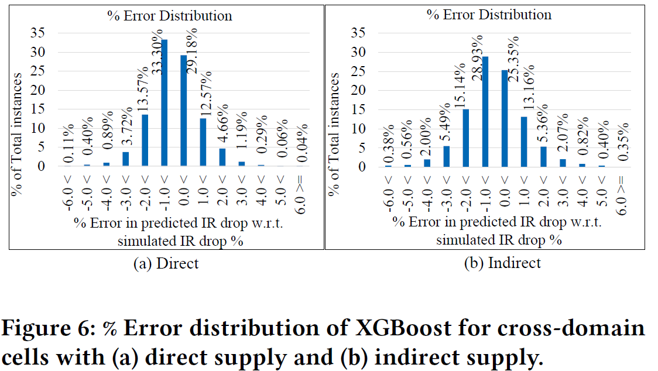
Methodology – ML Model

Slide 20
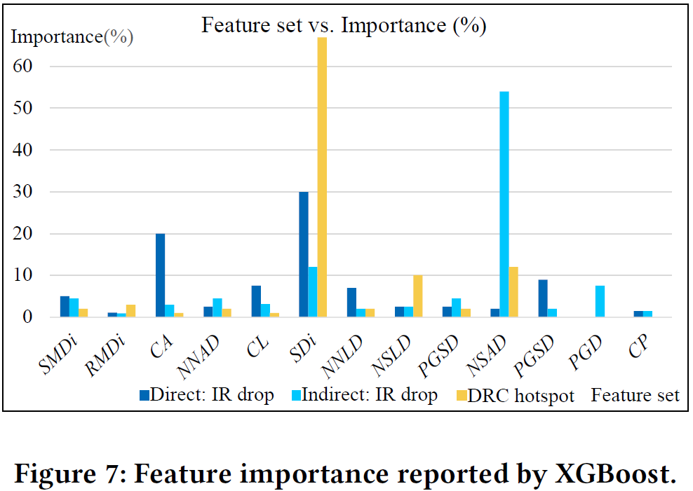
Methodology – ML Model

Slide 21
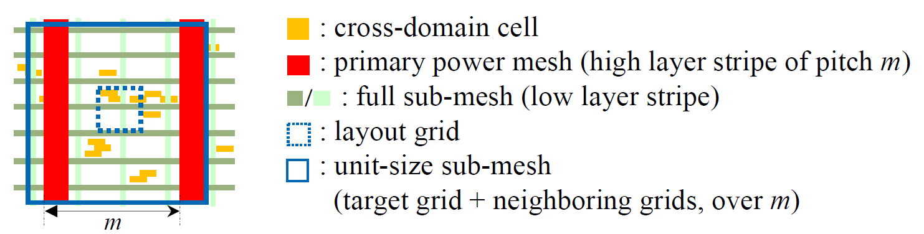
Methodology – Unit Size Selection for Sub-Meshes
The unit size of sub-mesh determines the search range for extracting features of neighboring cells.
A unit size of sub-mesh should overlap with the primary power mesh so that it can receive supply.
The unit size can contain more than one layout grid.

Slide 22
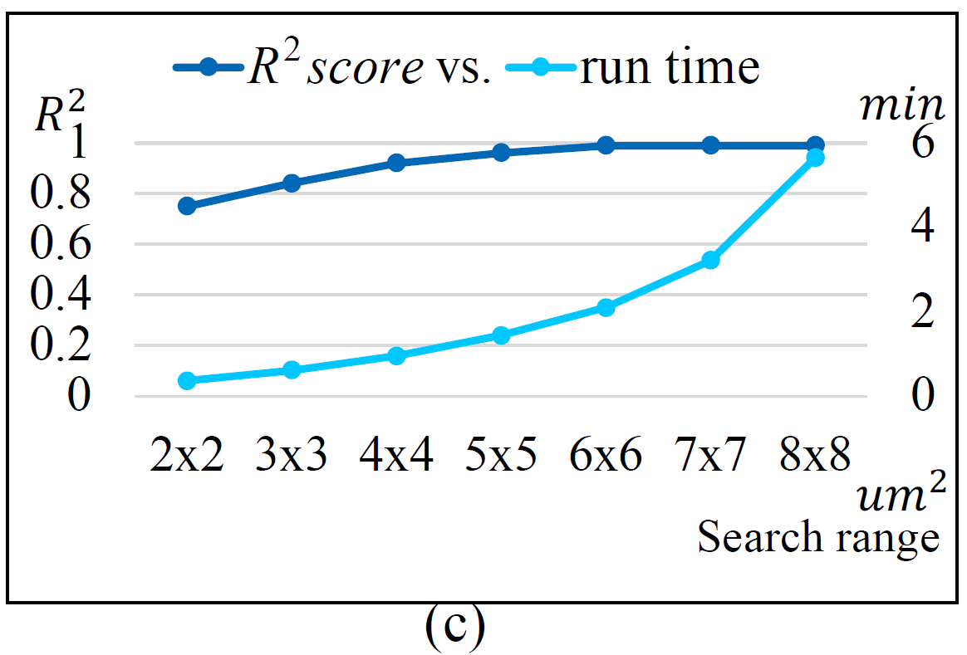
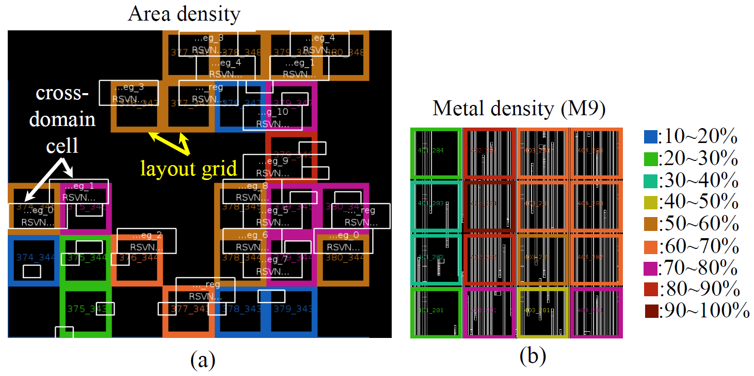

Methodology – Unit Size Selection for Sub-Meshes
Considering a layout grid of size $1×1$ ${nm}^{2}$.
Area density of neighboring cells.
The densities collected in each grid will be further merged as features.
Signal routing density within each layout grid.
The unit size is wider than the pitch of primary mesh
Notes:
所以sub mesh的unit size設為6*6 grid.

Slide 23
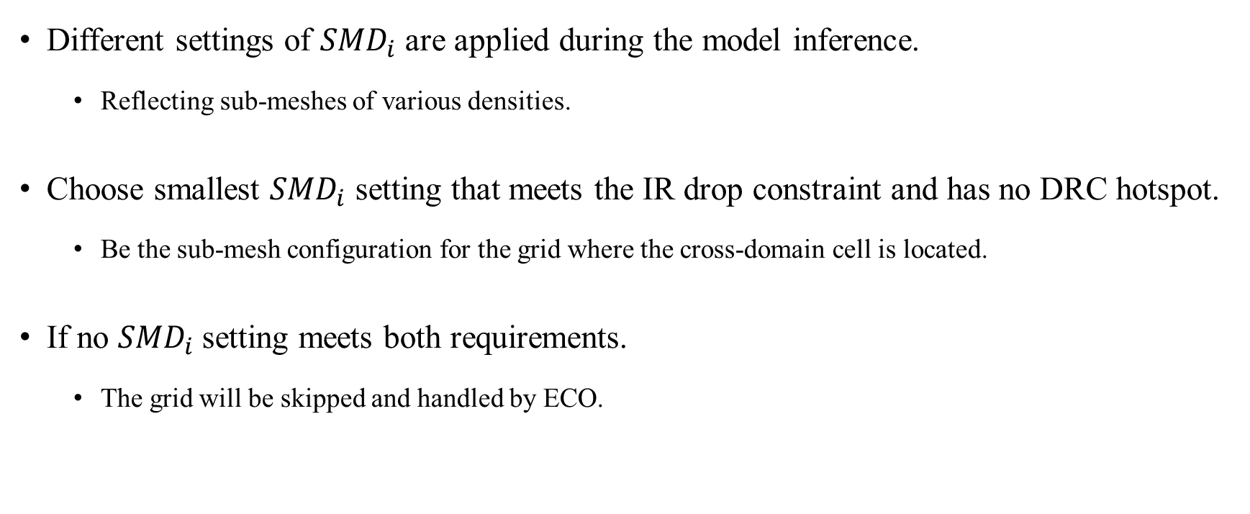
Methodology – Model Prediction and ECO Selection
Different settings of ${SMD}_{i}$ are applied during the model inference.
Reflecting sub-meshes of various densities.
Choose smallest ${SMD}_{i}$ setting that meets the IR drop constraint and has no DRC hotspot.
Be the sub-mesh configuration for the grid where the cross-domain cell is located.
If no ${SMD}_{i}$setting meets both requirements.
The grid will be skipped and handled by ECO.

Slide 24
Outline
Introduction
Preliminaries
Methodology
Experimental Results

Slide 25
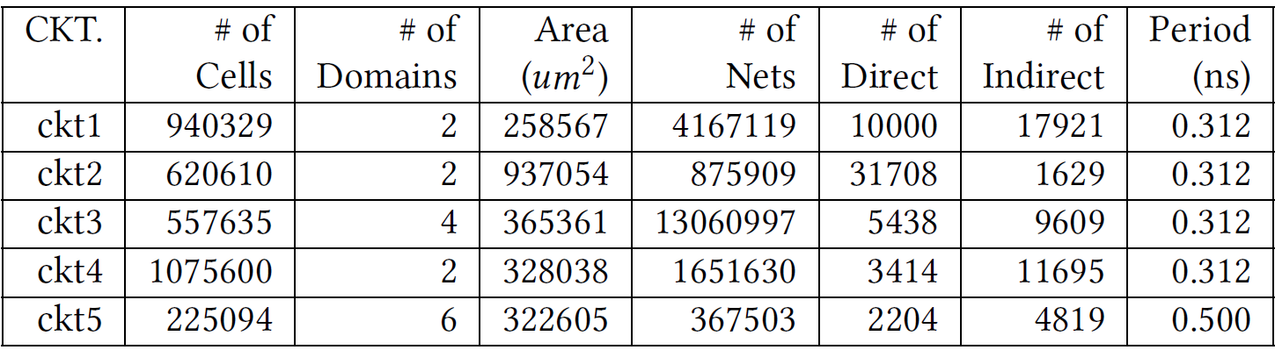
Experimental Result
Implement with C++, Tcl and Python 3.7.4 (scikit-learn package) language.
Intel Xeon Linux workstation
3.2 GHz CPU
512 GB memory
# of direct / indirect
Number of cross-domain cell instances with direct / indirect supply.
Training datasets: 2 power domains and 20k cross-domain cells

Slide 26
Experimental Result
Primary power mesh is constructed on metal 10 and metal 11 layers.
Sub-meshes are on metal 8 and metal 9 layers.
IR drop constraint is 3% of the working voltage.
All the design are placed at timing optimization mode by fusion compiler.
Timing is reported by primetime.
IR drop analysis in done by redhawk.

Slide 27
Experimental Result
None
No sub-mesh
Full
Full sub-mesh
GR-aware
Global route congestion-aware sub-mesh
Constructs sub-meshes only when the average layer-wise routing density is under 40%
Ours: ML
Predicted static IR drop should be less than strictly 1%
Zero DRC hotspots for each sub-mesh unit

Slide 28
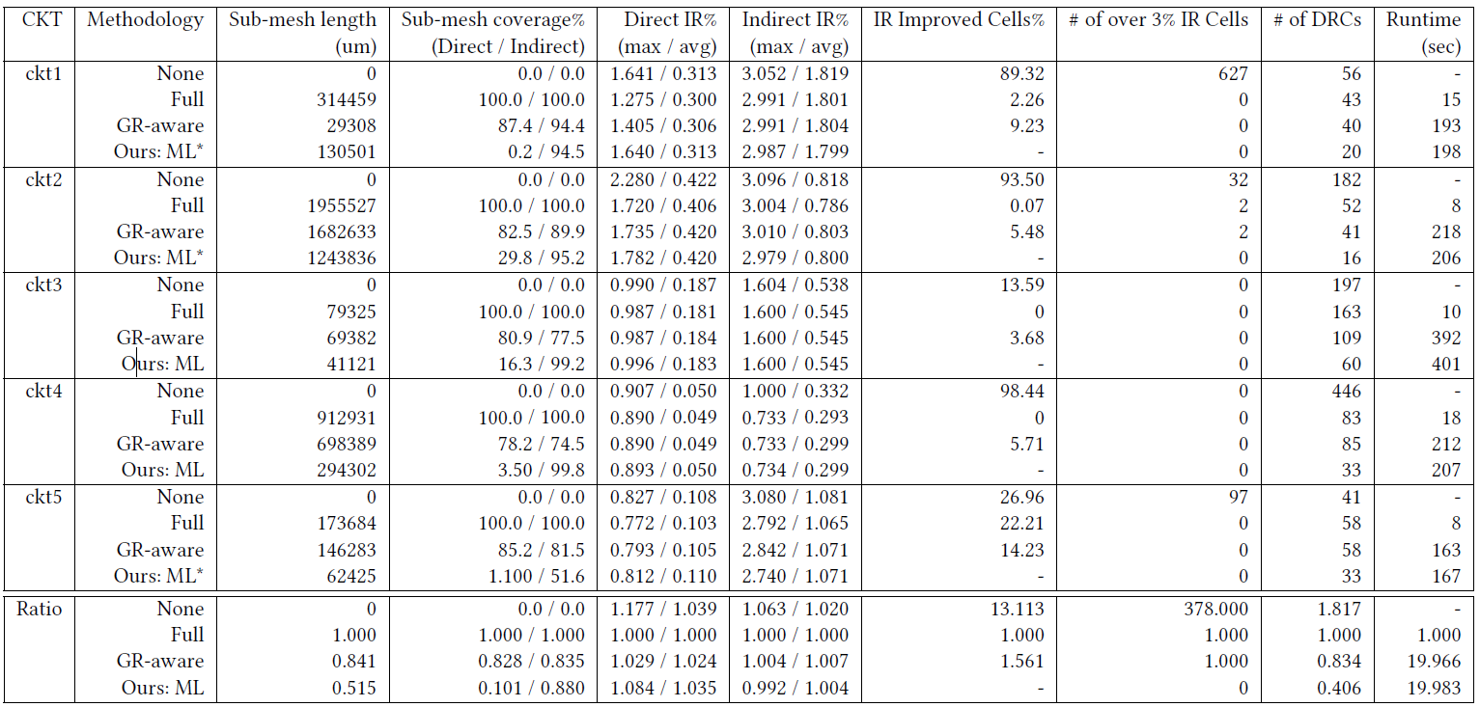
Notes:
sub-mesh length: sub-mesh的總線長
Sub-mesh coverage%: cross-domain cell所在的grid中，sub-mesh佔的百分比
Direct IR%: 跟direct supply連接的cross-domain cell最大/平均的IR Drop的比例

Slide 29
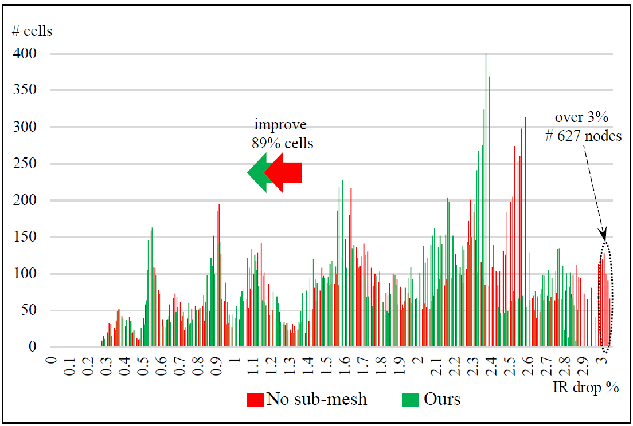
Experimental Result
IR drop optimization

Slide 30
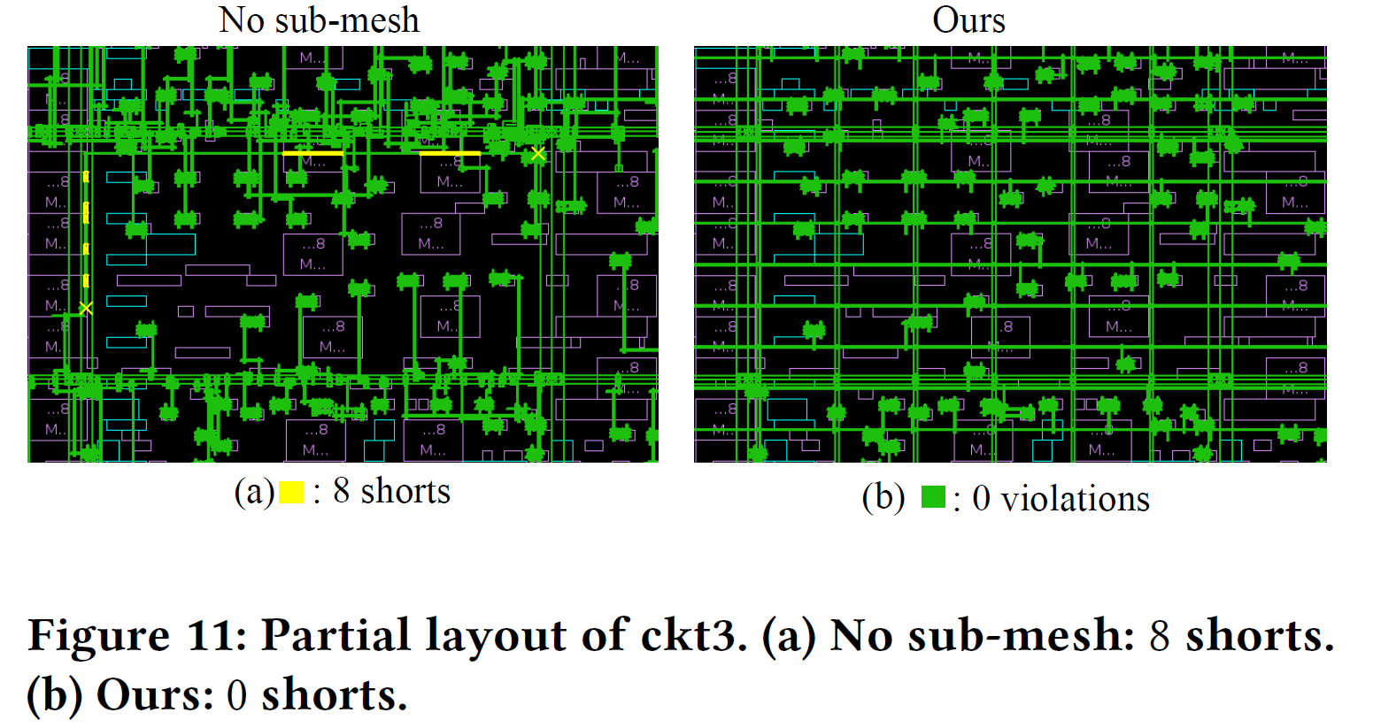
Experimental Result
Routability improvement (especially for congestion region)

Slide 31
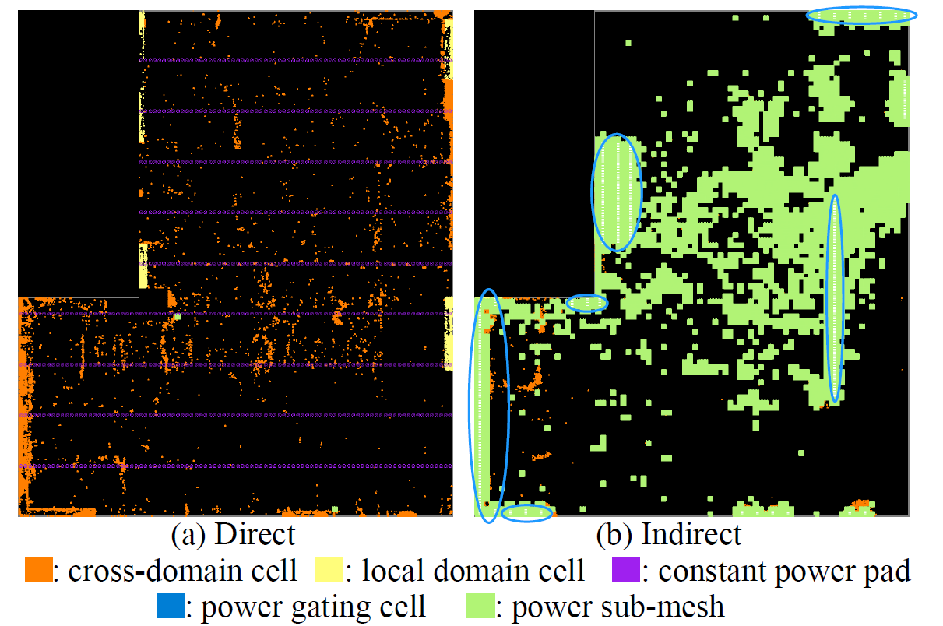
Experimental Result
Decreases the sub-mesh usage for cross-domain cells with direct supply.
Reserves more routing resource for the submesh of cross-domain cells with indirect supply.

Slide 32
Thank you for listening!

